Slide 1
Chi2

Slide 2
SelectKbest
K = 1/5

Slide 3
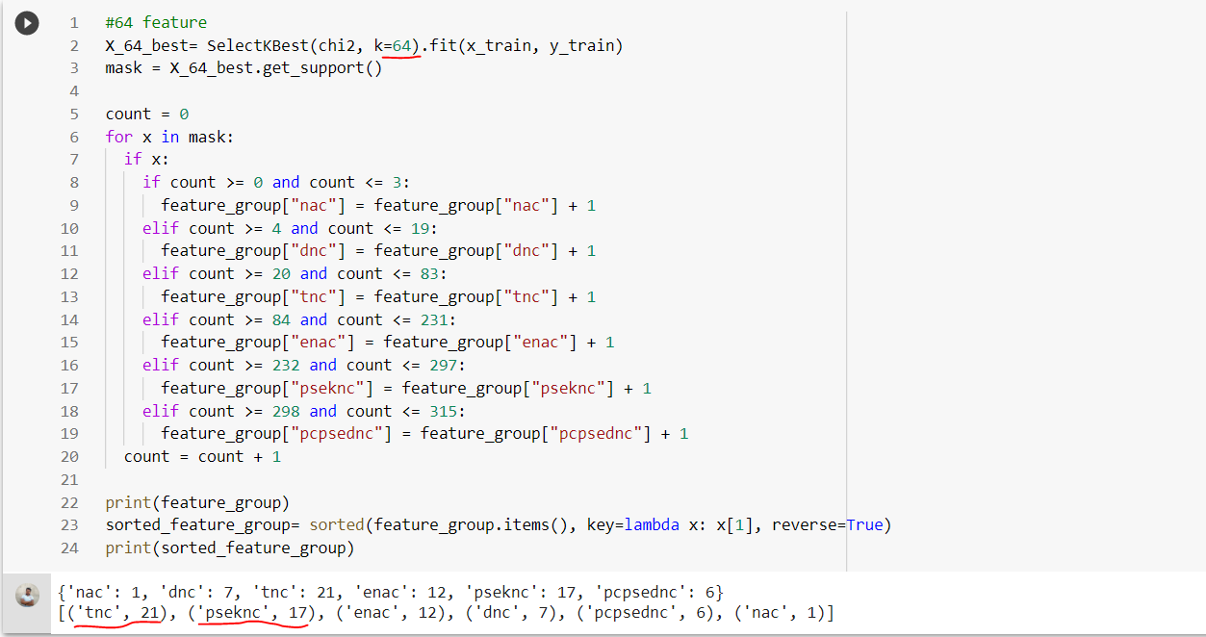

Slide 4
RFE
1/3, 1/5, 1/7

Slide 5
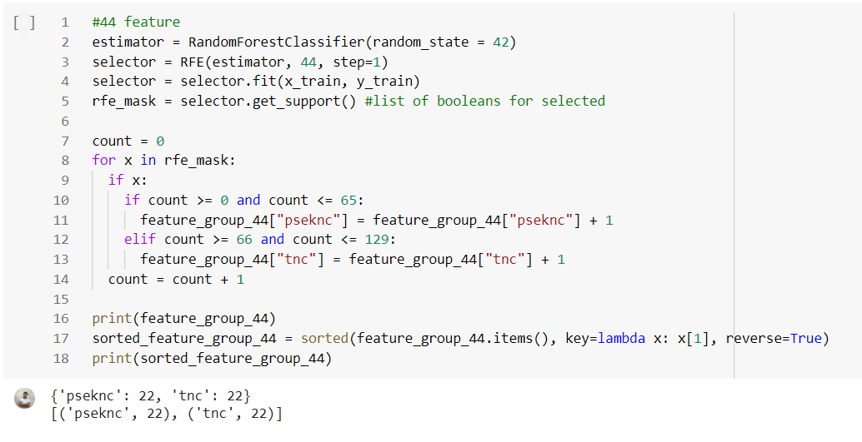
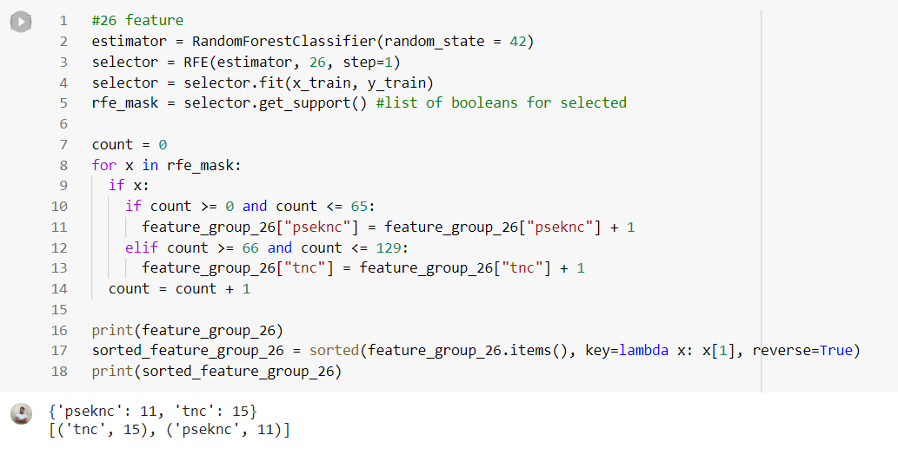
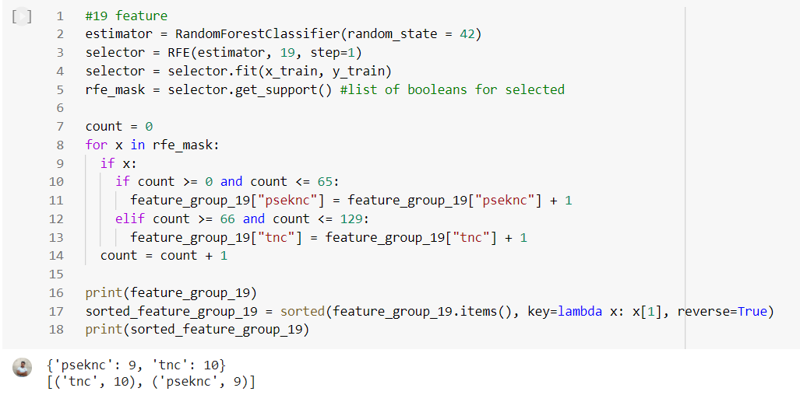
From here we picked tnc

Slide 6
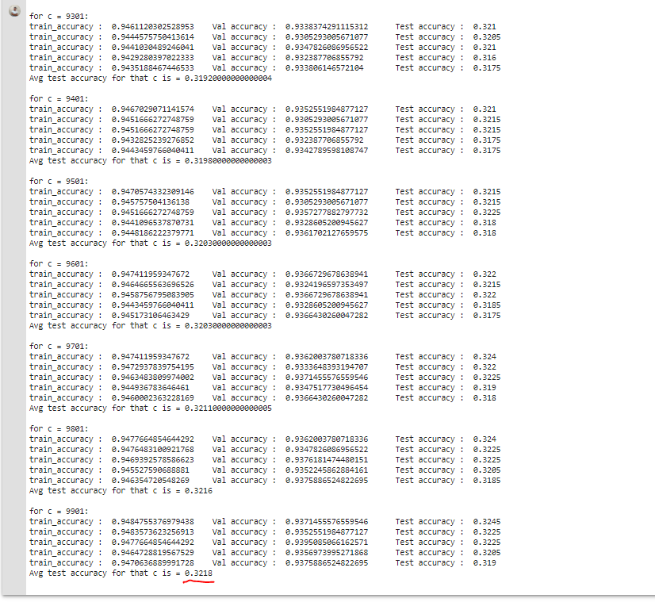
Here initially we put c = .001. Then we increased c value by .001. After 100 epochs we got 0.3218 as avg test accuracy when c = 0.1.

Slide 7
SelectKbest
K = 1/10

Slide 8
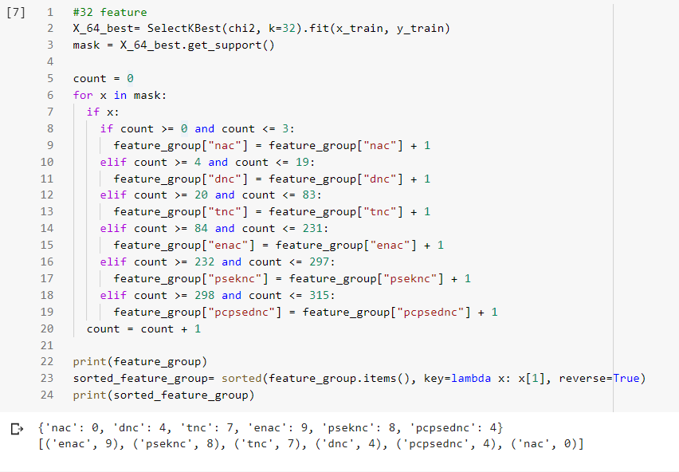

Slide 9
RFE
1/3, 1/5, 1/7

Slide 10
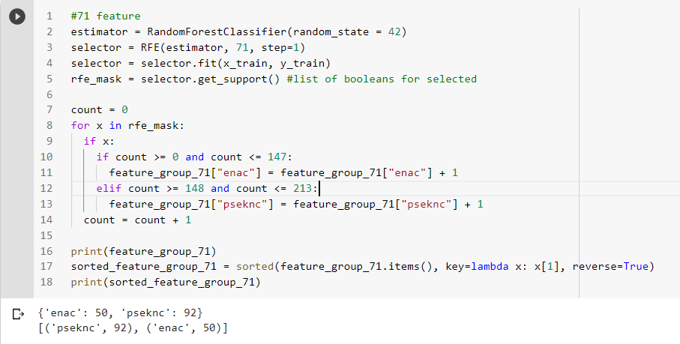
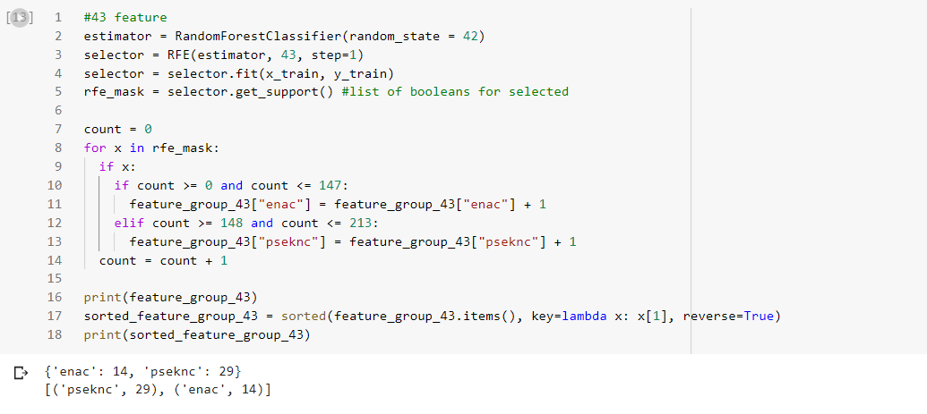
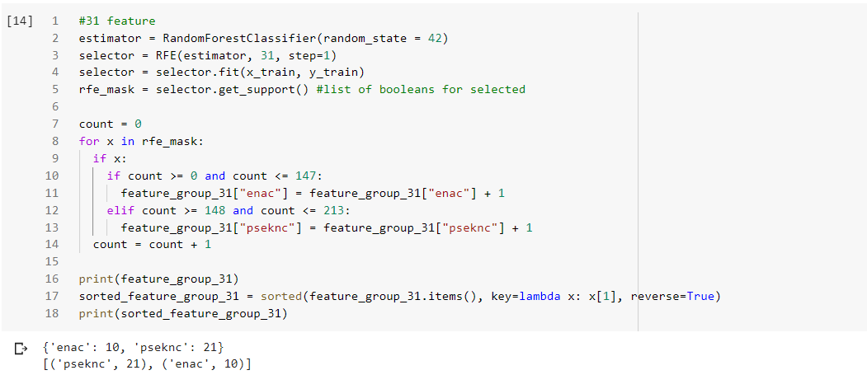
From here we picked pseknc

Slide 11
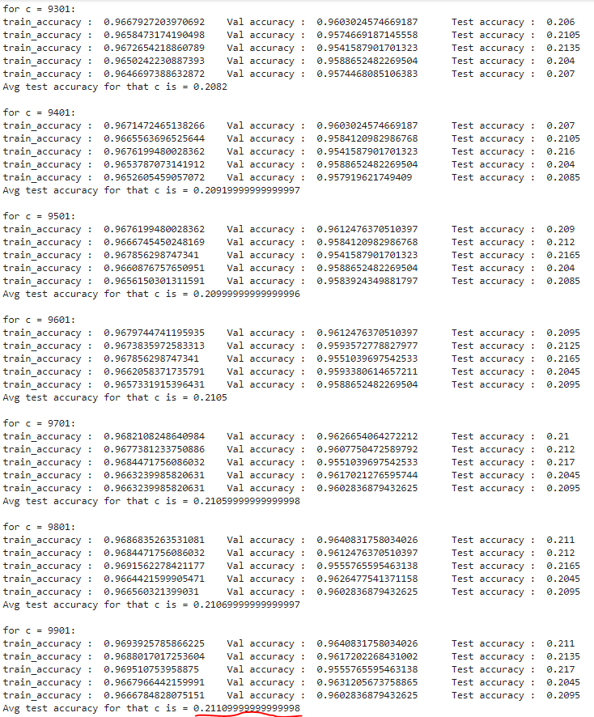
Here initially we put c = .001. Then we increased c value by .001. After 100 epochs we got 0.3218 as avg test accuracy when c = 0.1.

